Slide 1


DEPARTMENT OF ARTIFICIAL INTELLIGENCE AND DATA SCIENCE
TRA-WELL
Developers
HEMALATHA L
231801055
HARINI S 231801049

Slide 2
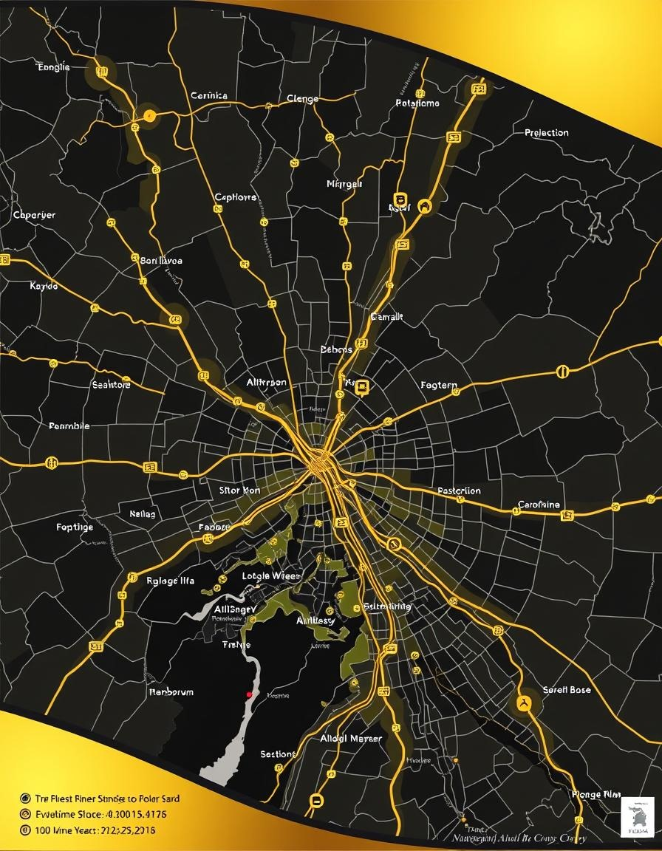
PROBLEM STATEMENT
Users need an intelligent, data-driven system to predict travel times accurately and suggest optimal routes by analyzing traffic patterns, weather conditions, and route distances. This can save time, reduce fuel costs, and improve overall travel experience.
MOTIVATION
The Tra-Well project aims to tackle the growing challenges of traffic congestion and unpredictable travel times by leveraging machine learning to deliver accurate, data-driven route planning. This smart solution minimizes fuel consumption, saves time, and enhances commuting efficiency for users...

Slide 3




OBJECTIVES
Time Savings
By providing the most efficient route recommendations, the system will help commuters save valuable time, allowing them to spend less time in traffic and more time on productive or personal activities.
Fuel Efficiency
The system's focus on fuel-efficient routes will contribute to reduced fuel consumption and lower environmental impact, supporting sustainable transportation initiatives in urban areas.
Reduced Stress
The reliable and responsive nature of the route recommendation system will alleviate the anxiety and frustration often associated with navigating through unpredictable traffic conditions, leading to a more positive commuting experience.
Economic Benefits
By optimizing transportation efficiency and reducing congestion, the system can contribute to improved economic productivity and competitiveness for businesses and individuals in urban areas.

Slide 4

ABSTRACT
In today's bustling urban landscapes, navigating through congested traffic remains a persistent challenge. This project develops an enhanced route planning application that provides users with multiple route options between a source and destination, along with traffic-aware estimates of travel time. The system utilizes graph-based routing, historical traffic patterns, and real-time simulations to predict congestion levels and their impact on travel time. By incorporating machine learning, the application learns from past data to improve its travel time estimates. An interactive map visualizes the route options, travel duration, distance, and traffic density, enabling users to make informed transportation decisions.

Slide 5
INTRODUCTION
Traffic congestion and unpredictable travel times have become significant challenges in urban areas, impacting daily commuters and logistics operations. To address these issues, Tra-Well offers an intelligent traffic route planning solution powered by machine learning. The project predicts travel times based on factors like distance, traffic density, and weather conditions, enabling users to make informed decisions and select the most efficient routes.
OVERVIEW
Tra-Well: A Traffic Route Planner is a machine learning-based solution designed to optimize travel routes and predict travel times. It uses a Random Forest Regressor to estimate travel durations by analyzing key factors like route length, traffic conditions, and time of day. The project integrates tools like OSMnx for map data and Folium for interactive route visualization, providing users with clear and practical insights. Tra-Well aims to enhance travel efficiency, offering a reliable and user-friendly platform for smarter commuting decisions.

Slide 6
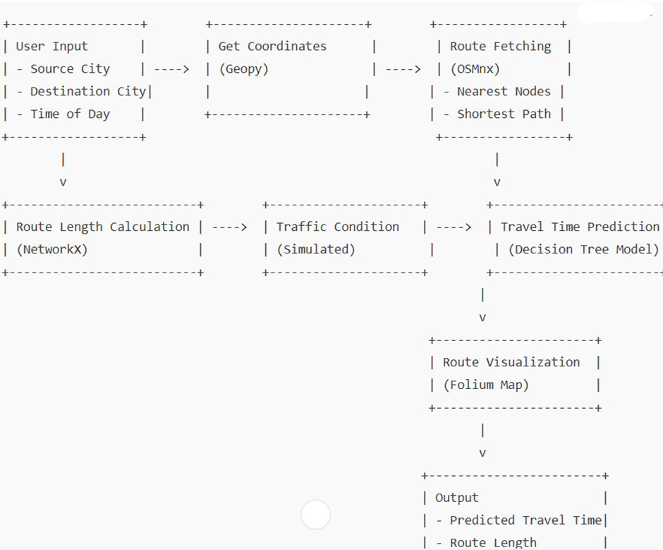
ARCHITECTURE OF WORK FLOW
User Input: The user provides source and destination cities along with the time of travel.
Data Processing: The system fetches map data using OSMnx and calculates the shortest route between the locations.
Feature Extraction: Key features like route length, traffic conditions (simulated), and time of day are prepared as input for the ML model.
Travel Time Prediction: A pre-trained Random Forest Regressor predicts the travel time based on the extracted features.
Visualization: The route is plotted on an interactive map using Folium and saved as an HTML file for the user to view.
Output: The system displays the predicted travel time and route details, enabling users to plan their journey efficiently.

Slide 7








WORK FLOW OF THE ML MODEL
Data Collection: Gather historical traffic data from sources. Include weather and local event data to enhance prediction accuracy and account for external factors.
Data Preprocessing: Clean the dataset by addressing missing values and inconsistencies. Create useful features such as day of the week, time of day, and historical traffic patterns to enrich the model inputs.
Feature Selection: Identify key features that significantly affect travel time. Focus on elements like route length, historical traffic volume, weather conditions, and time of travel to optimize model performance.
Model Selection: Use appropriate algorithms for each task: Dijkstra’s or A* for route suggestions, regression models for traffic volume predictions, and advanced regression techniques for estimating travel times.
Model Training: Split data into training and testing sets for model evaluation. Train models using regression metrics like MAE and RMSE, and optimize performance through hyperparameter tuning.
Prediction and Recommendation: Integrate real-time data to predict current traffic conditions. Provide users with recommended routes based on predicted travel times, allowing them to choose based on their preferences.
Model evaluation: Assess model accuracy using metrics such as MAE for travel time predictions and accuracy for route suggestions. Continuously improve models based on user feedback and performance tracking.
Deployment:
Deploy the solution in a user-friendly application where users can input their source and destination. Monitor model performance and update data to ensure ongoing accuracy and relevance.
Data collection
Data pre-processing
Feature selection
Model prediction
Model training
Model selection
Model evaluation
Deployment

Slide 8
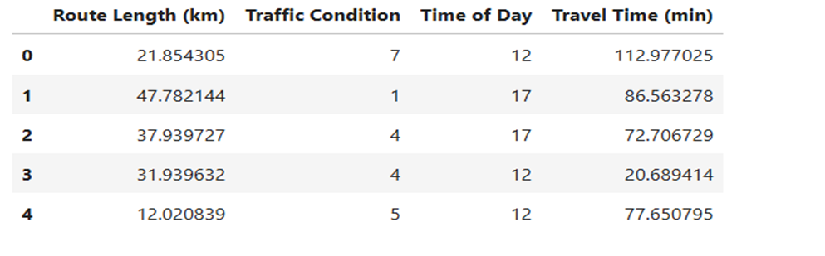
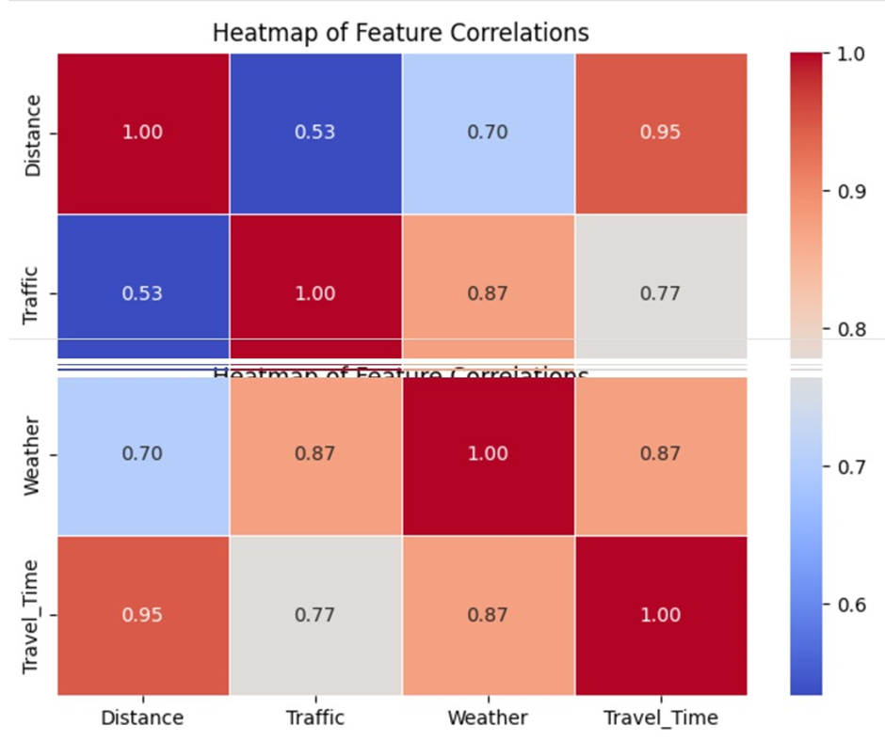
DATA PREPARATION
The first step is to create or collect the dataset for predicting travel times in urban traffic scenarios. The dataset can be generated using synthetic data based on real-world factors that influence travel durations. To prepare the dataset for predicting travel times, we preprocess the data by handling missing values, encoding categorical variables, and scaling numerical features. Numerical features like route length and traffic condition are standardized to ensure they are on a similar scale, improving the model's ability to learn patterns effectively. Additionally, categorical variables, such as time of day (if represented categorically), are encoded using one-hot encoding to convert them into a machine-learning-friendly format. These preprocessing steps ensure the dataset is clean and well-structured, allowing the model to effectively analyze the data and make accurate travel time predictions.

Slide 9
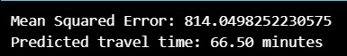
MODEL EVALUATION
The model is trained on historical travel time data, with the performance evaluated using various metrics. Mean Squared Error (MSE) is the primary metric to assess how closely the predicted travel times match the actual travel times. Cross-validation, specifically K-fold cross-validation, is used to evaluate the model’s robustness by splitting the data into multiple subsets, training the model on some and testing it on others. Hyperparameter tuning, such as adjusting the maximum depth of the tree or the minimum number of samples per leaf, helps prevent overfitting and improves the model's generalizability. Evaluation metrics like accuracy, RMSE (Root Mean Squared Error), and cross-validation scores provide insights into the model’s prediction accuracy and its ability to generalize to unseen data.

Slide 10
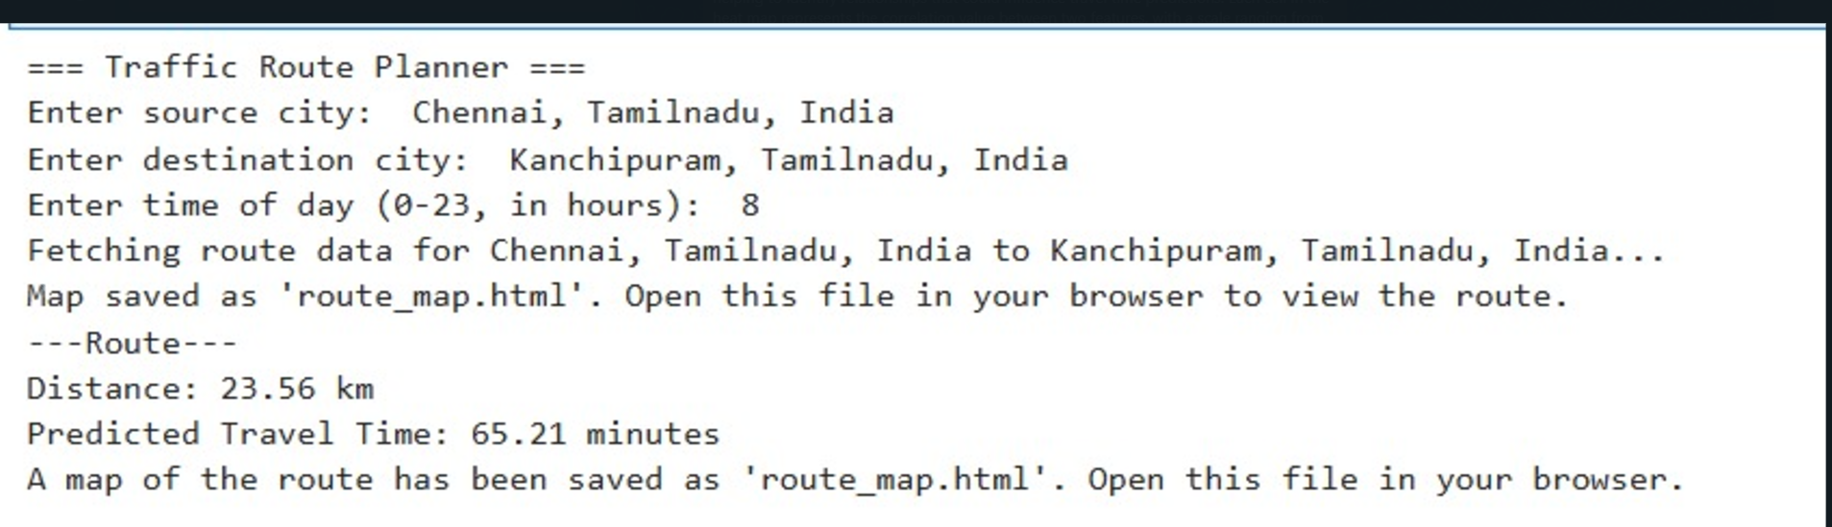
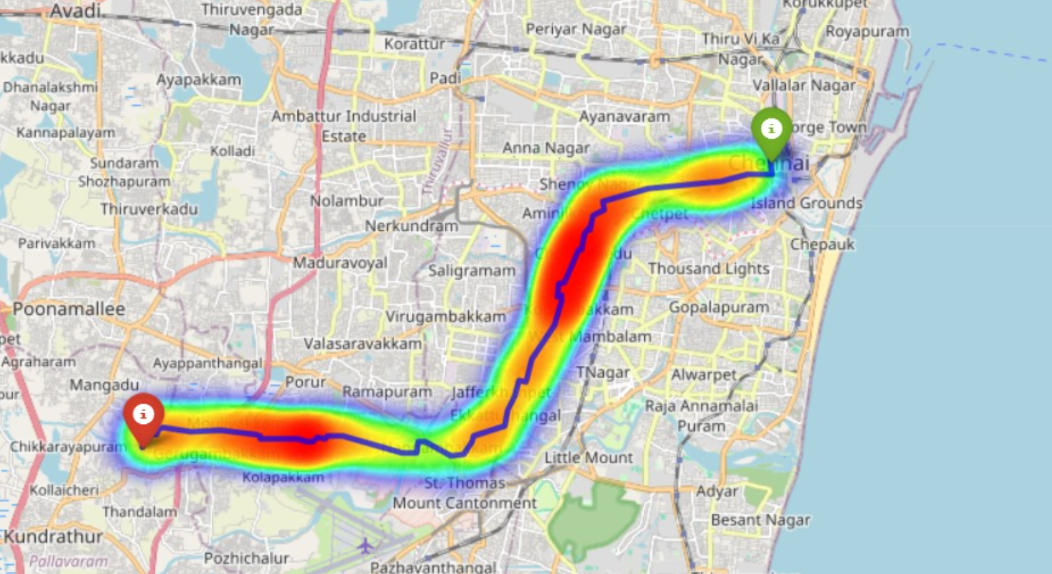
RESULT

Slide 11
CONCLUSION
In conclusion, our project, Tra-Well: A Traffic Route Planner, successfully integrates machine learning with geospatial analysis to predict travel times and provide optimized route suggestions for users. By utilizing a Random Forest Regressor, we demonstrated the ability to predict travel time accurately based on key factors such as route length, traffic conditions, and time of day. This prediction aids users in making informed decisions about their travel plans, ensuring greater efficiency and convenience.The use of OSMnx and NetworkX for mapping and route optimization, coupled with an interactive visualization using Folium, highlights the project's practical applicability. The integration of machine learning enables dynamic travel time estimation, which can be further enhanced by incorporating real-time traffic data and user-specific patterns.
Overall, Tra-Well demonstrates the potential of combining machine learning with geospatial technology to address everyday challenges in urban mobility. This project lays a strong foundation for future innovations in smart route planning and personalized travel assistance, ultimately contributing to more efficient and user-centric transportation systems.

Slide 12

REFERENCE
https://www.javatpoint.com/traffic-prediction-using-machine-learning
https://www.sciencedirect.com/science/article/abs/pii/S1568494621001927
https://www.scribd.com/document/727711105/Traffic-Prediction-and-Route-Optimization-saran
https://www.researchgate.net/publication/271191935_Route_Planning_with_Real-Time_Traffic_Predictions

